Slide 1
Bayesian Inference
Module 4, Lesson 2

Slide 2
Large Sample Theory
Shahrzad Jamshidi, PhD

Slide 3
Last Time
Normal Approximation of distributions

Slide 4
Objectives
Grasp the fundamentals of large-sample theory in the context of Bayesian inference.
Identify and understand counterexamples to large-sample theorems.

Slide 5
Large-Sample Theory
Large sample theory, also known as asymptotic theory, is a branch of statistics that
studies the properties and behavior of statistical estimators and
tests as the sample size grows infinitely large.
It provides approximations that are useful for understanding the behavior of statistical procedures when dealing with large datasets.
We will use large sample theory to understand why normal approximation is often reasonable.

Slide 6
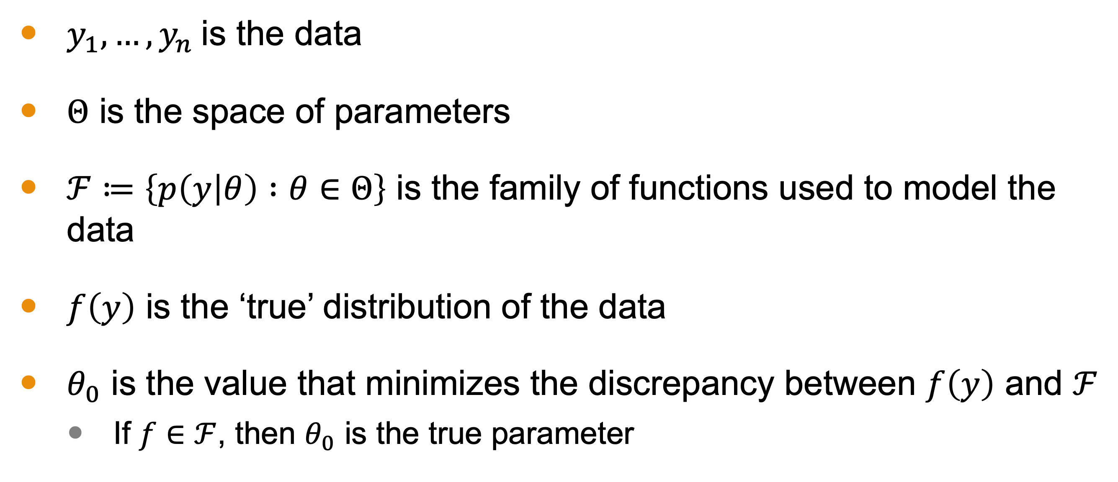
Notation
$y_{1},…,y_{n}$ is the data
$Θ$ is the space of parameters
$ℱ≔\left\{p\left(y | θ\right) :θ∈Θ\right\}$ is the family of functions used to model the data
$f\left(y\right)$ is the ‘true’ distribution of the data
$θ_{0}$ is the value that minimizes the discrepancy between $f\left(y\right)$ and $ℱ$
If $f∈ℱ$, then $θ_{0}$ is the true parameter

Slide 7

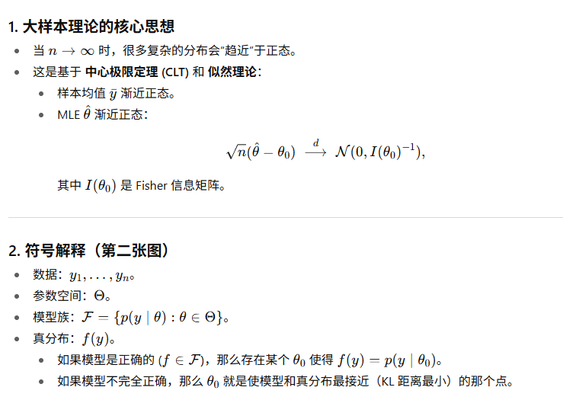
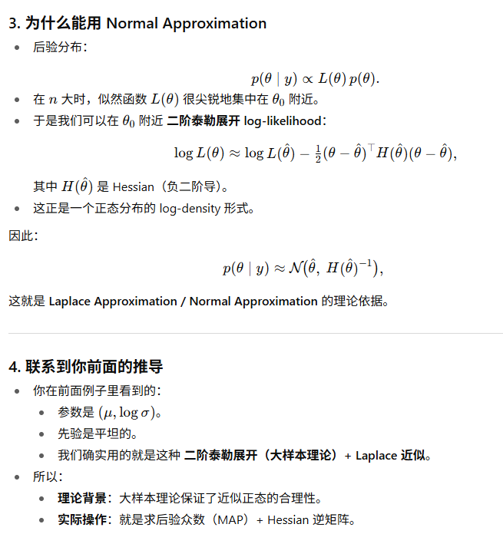
Notes:
Explain the meaning of the notation with an example

Slide 8
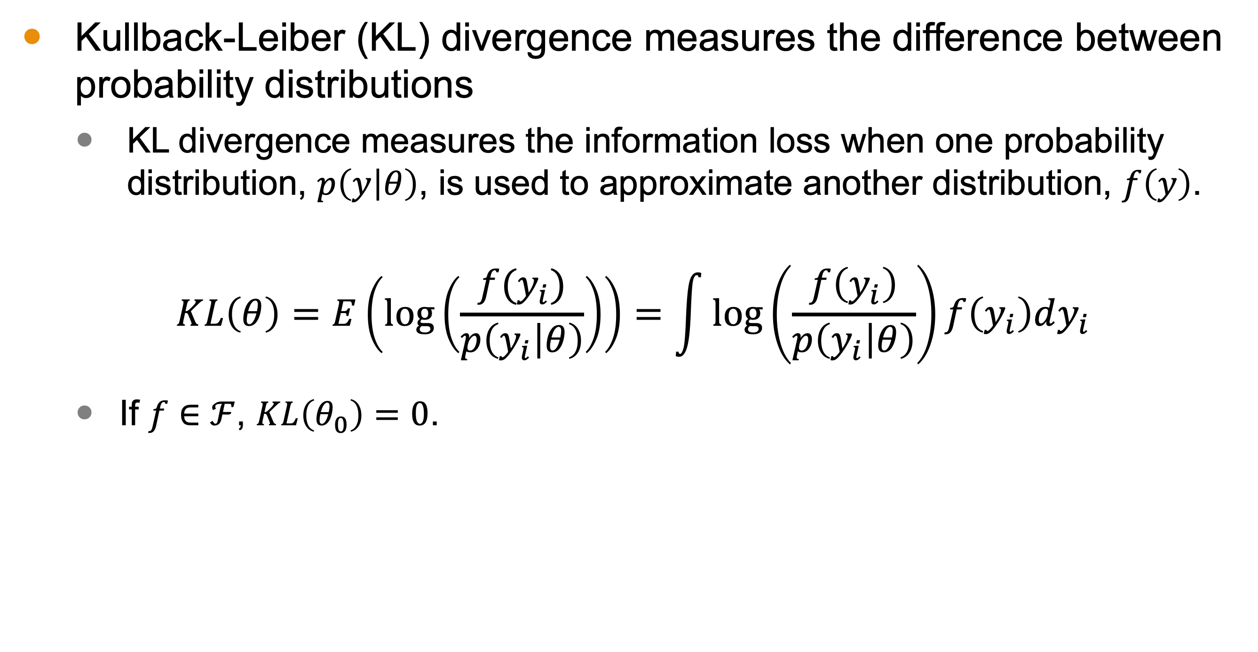
Kullback-Leiber (KL) Divergence
Kullback-Leiber (KL) divergence measures the difference between probability distributions
KL divergence measures the information loss when one probability distribution, $p\left(y | θ\right)$, is used to approximate another distribution, $f\left(y\right)$.
$$KL\left(θ\right)=E\left(\log\left(\frac{f(y_{i})}{p\left(y_{i} | θ\right)}\right)\right)=\int{\log\left(\frac{f\left(y_{i}\right)}{p\left(y_{i} | θ\right)}\right)}f\left(y_{i}\right)dy_{i}$$
If $f∈ℱ$, $KL\left(θ_{0}\right)=0$.

Slide 9
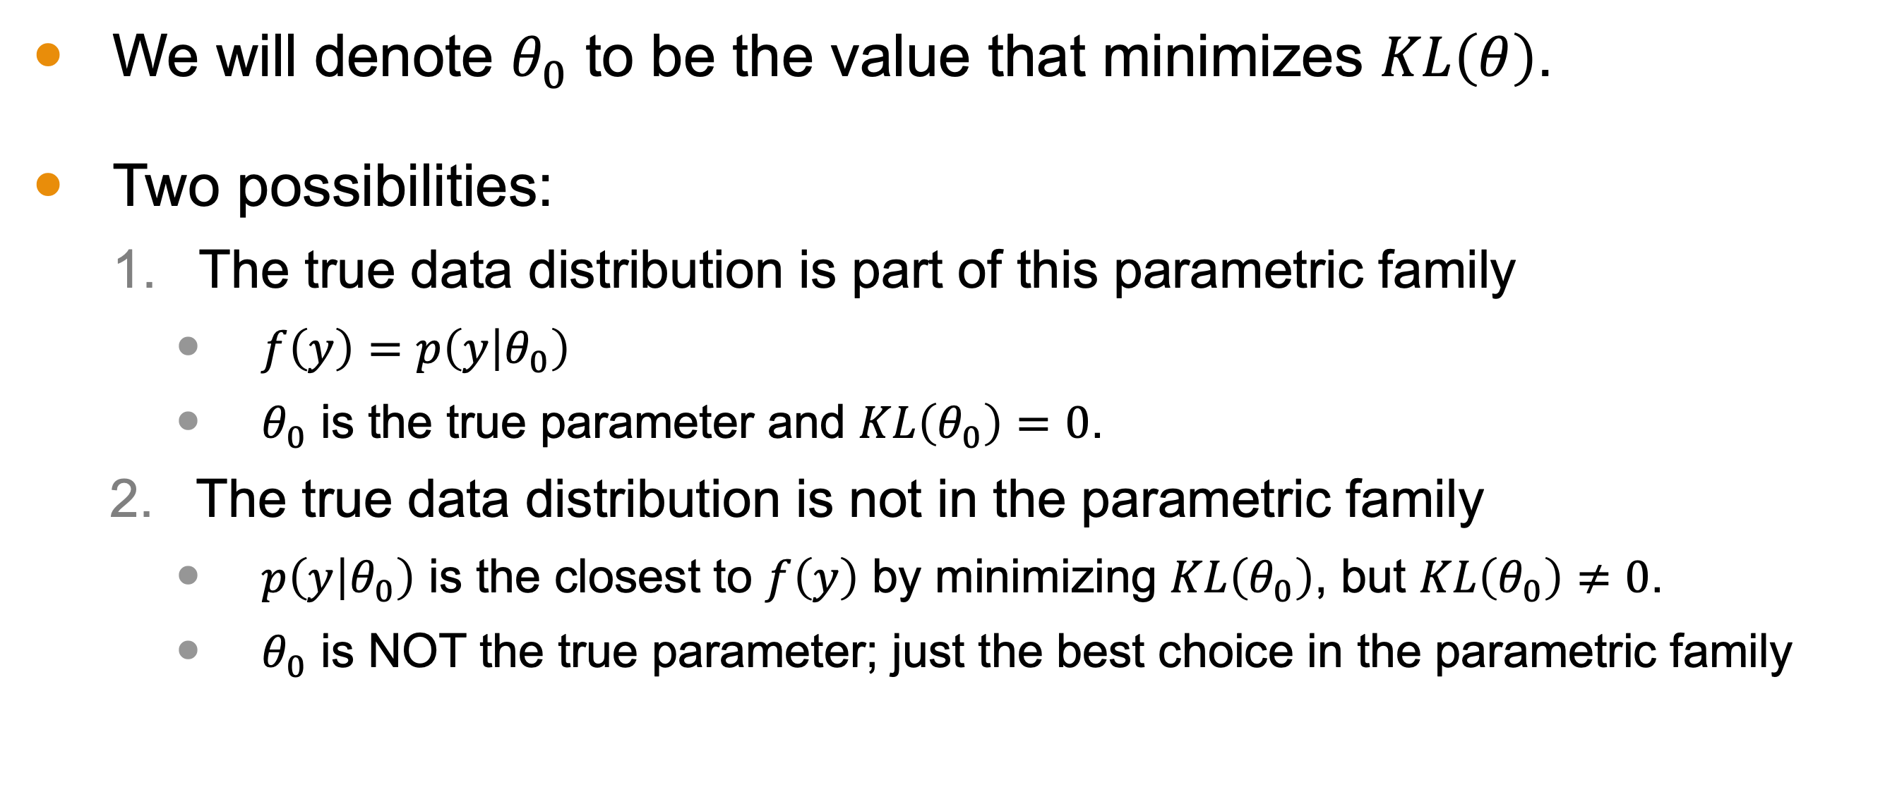
Mathematical Setup
We will denote $θ_{0}$ to be the value that minimizes $KL\left(θ\right)$.
Two possibilities:
The true data distribution is part of this parametric family
$f\left(y\right)=p\left(y | θ_{0}\right)$
$θ_{0}$ is the true parameter and $KL\left(θ_{0}\right)=0$.
The true data distribution is not in the parametric family
$p\left(y | θ_{0}\right)$ is the closest to $f\left(y\right)$ by minimizing $KL\left(θ_{0}\right)$, but $KL\left(θ_{0}\right)≠0$.
$θ_{0}$ is NOT the true parameter; just the best choice in the parametric family

Slide 10
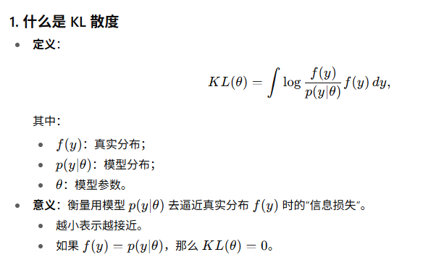
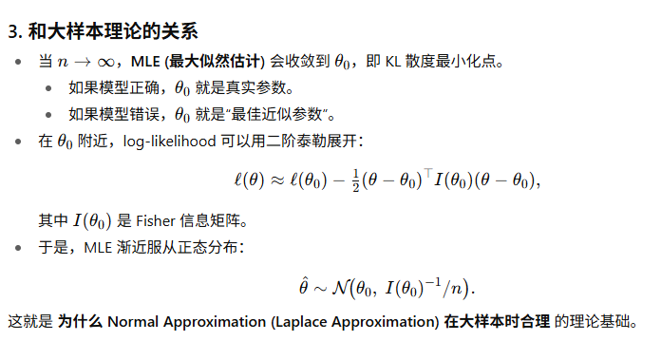
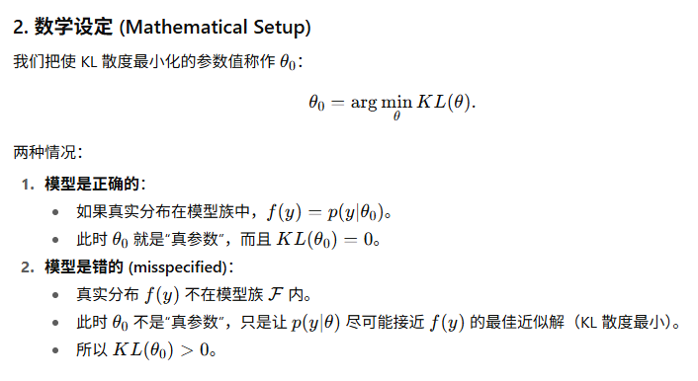
Notes:
Explain the meaning of the notation with an example

Slide 11
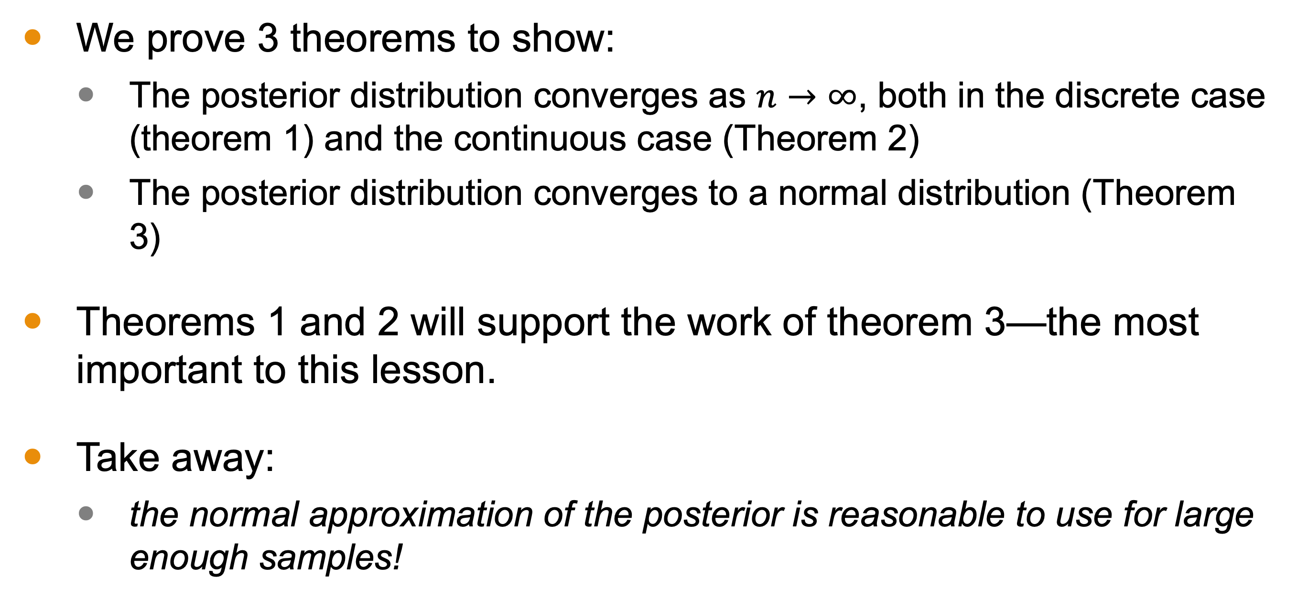
We Will Prove 3 Theorems
We prove 3 theorems to show:
The posterior distribution converges as $n→∞$, both in the discrete case (theorem 1) and the continuous case (Theorem 2)
The posterior distribution converges to a normal distribution (Theorem 3)
Theorems 1 and 2 will support the work of theorem 3—the most important to this lesson.
Take away:
the normal approximation of the posterior is reasonable to use for large enough samples!

Slide 12
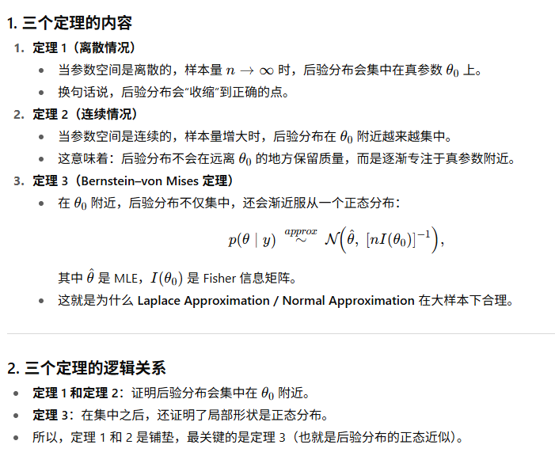
Notes:
Proof of theorem 1

Slide 13
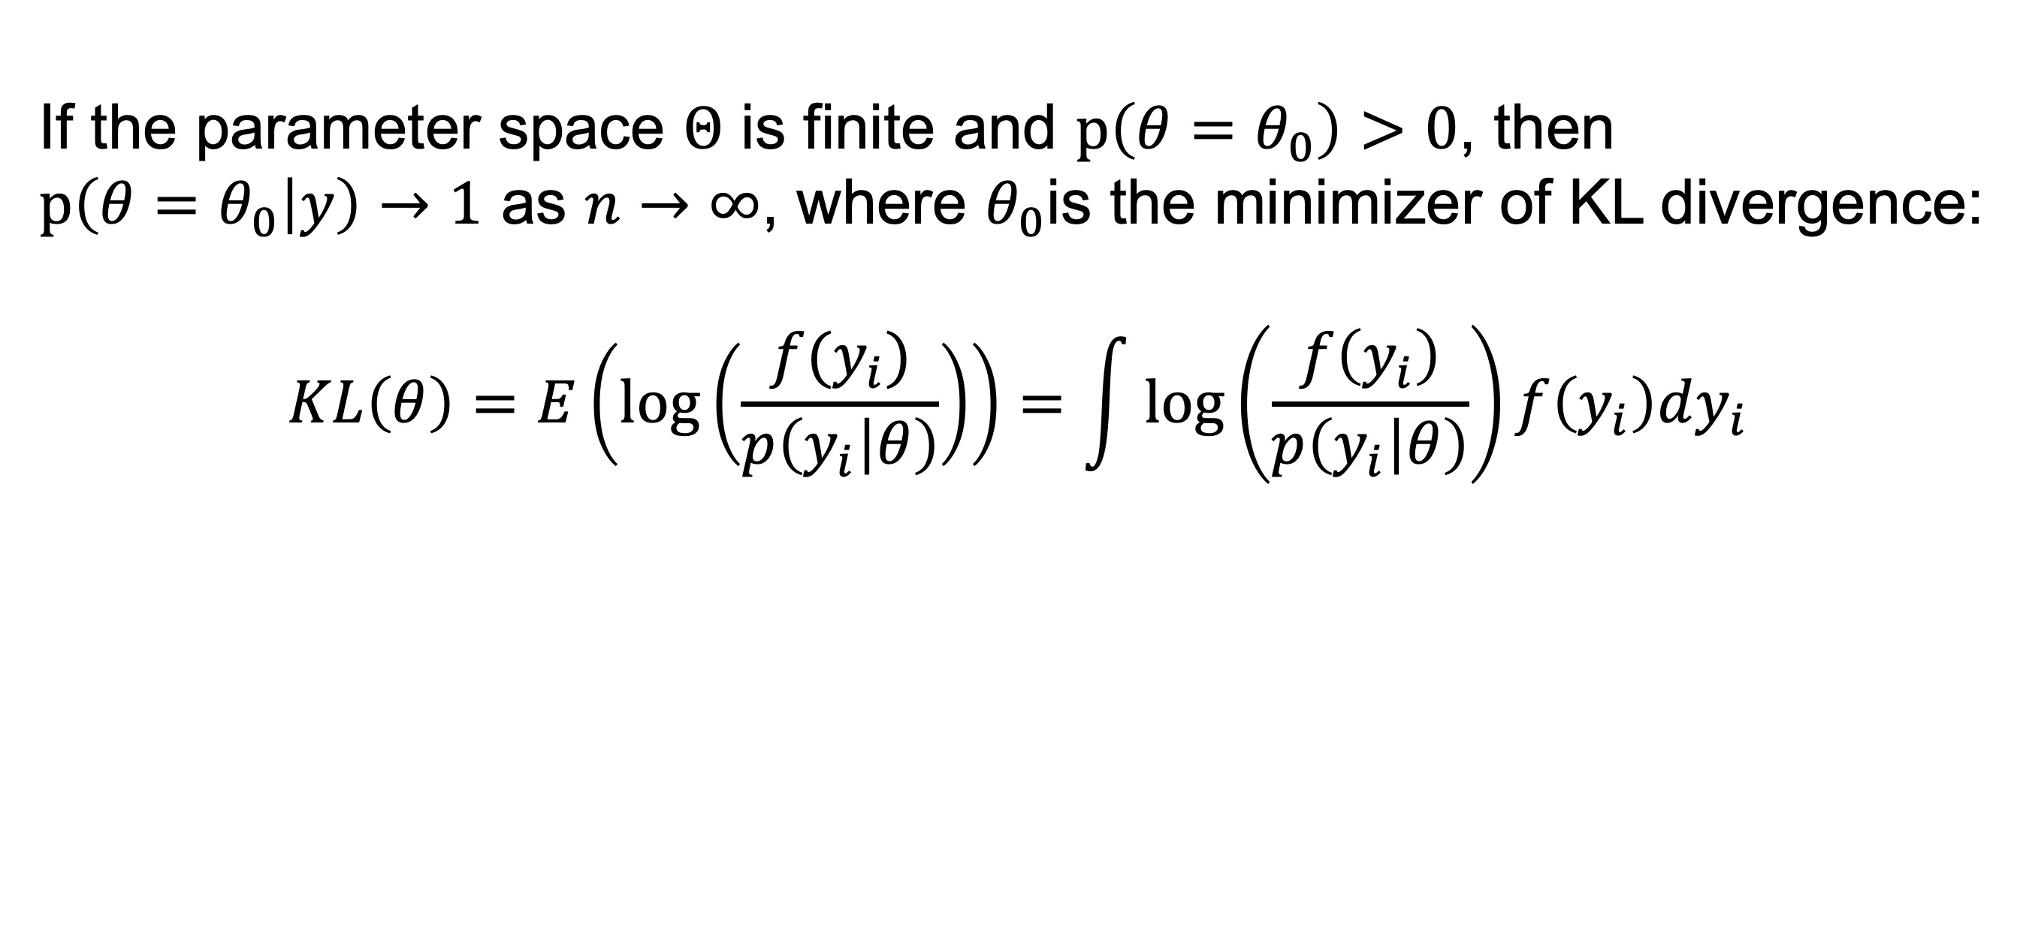
Theorem 1
If the parameter space $Θ$ is finite and $p\left(θ=θ_{0}\right)>0$, then $p\left(θ=θ_{0} | y\right)→1$ as $n→∞$, where $θ_{0}$is the minimizer of KL divergence:
$$KL\left(θ\right)=E\left(\log\left(\frac{f(y_{i})}{p\left(y_{i} | θ\right)}\right)\right)=\int{\log\left(\frac{f\left(y_{i}\right)}{p\left(y_{i} | θ\right)}\right)}f\left(y_{i}\right)dy_{i}$$

Slide 14
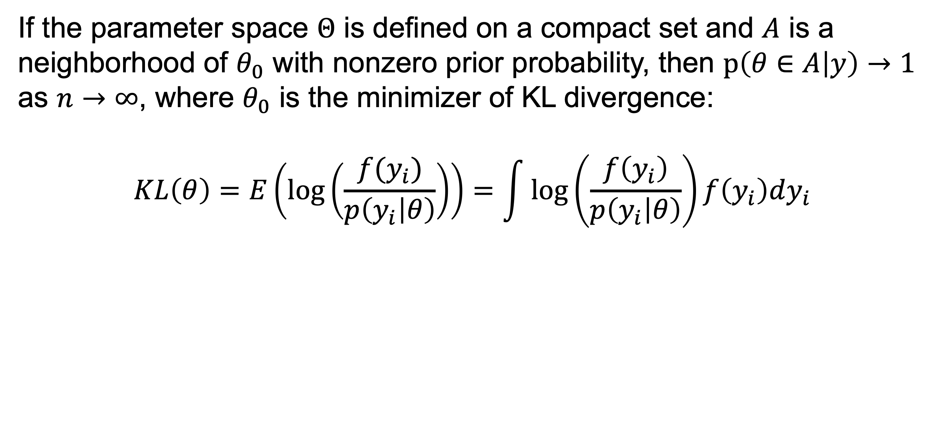
Theorem 2
If the parameter space $Θ$ is defined on a compact set and $A$ is a neighborhood of $θ_{0}$ with nonzero prior probability, then $p\left(θ∈A | y\right)→1$ as $n→∞$, where $θ_{0}$ is the minimizer of KL divergence:
$$KL\left(θ\right)=E\left(\log\left(\frac{f(y_{i})}{p\left(y_{i} | θ\right)}\right)\right)=\int{\log\left(\frac{f\left(y_{i}\right)}{p\left(y_{i} | θ\right)}\right)}f\left(y_{i}\right)dy_{i}$$

Slide 15
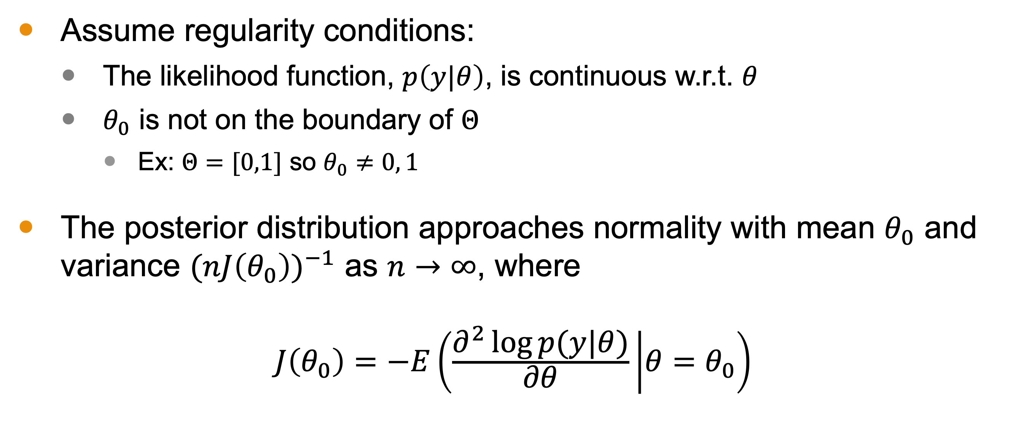
Theorem 3
Assume regularity conditions:
The likelihood function, $p\left(y|θ\right)$, is continuous w.r.t. $θ$
$θ_{0}$ is not on the boundary of $Θ$
Ex: $Θ=[0,1]$ so $θ_{0}≠0, 1$
The posterior distribution approaches normality with mean $θ_{0}$ and variance ${(nJ\left(θ_{0}\right))}^{−1}$ as $n→∞$, where
$$J\left(θ_{0}\right)=−E\left(\frac{∂^{2}\log{p(y|θ)}}{∂θ} | θ=θ_{0}\right)$$

Slide 16
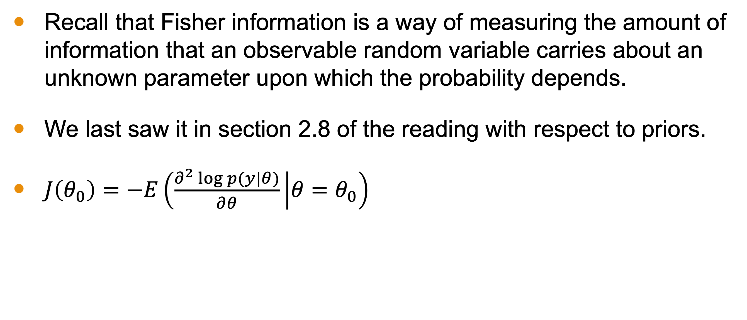

$J\left(θ_{0}\right)$, the Fisher Information
Recall that Fisher information is a way of measuring the amount of information that an observable random variable carries about an unknown parameter upon which the probability depends.
We last saw it in section 2.8 of the reading with respect to priors.
$J\left(θ_{0}\right)=−E\left(\frac{∂^{2}\log{p(y|θ)}}{∂θ} | θ=θ_{0}\right)$

Slide 17
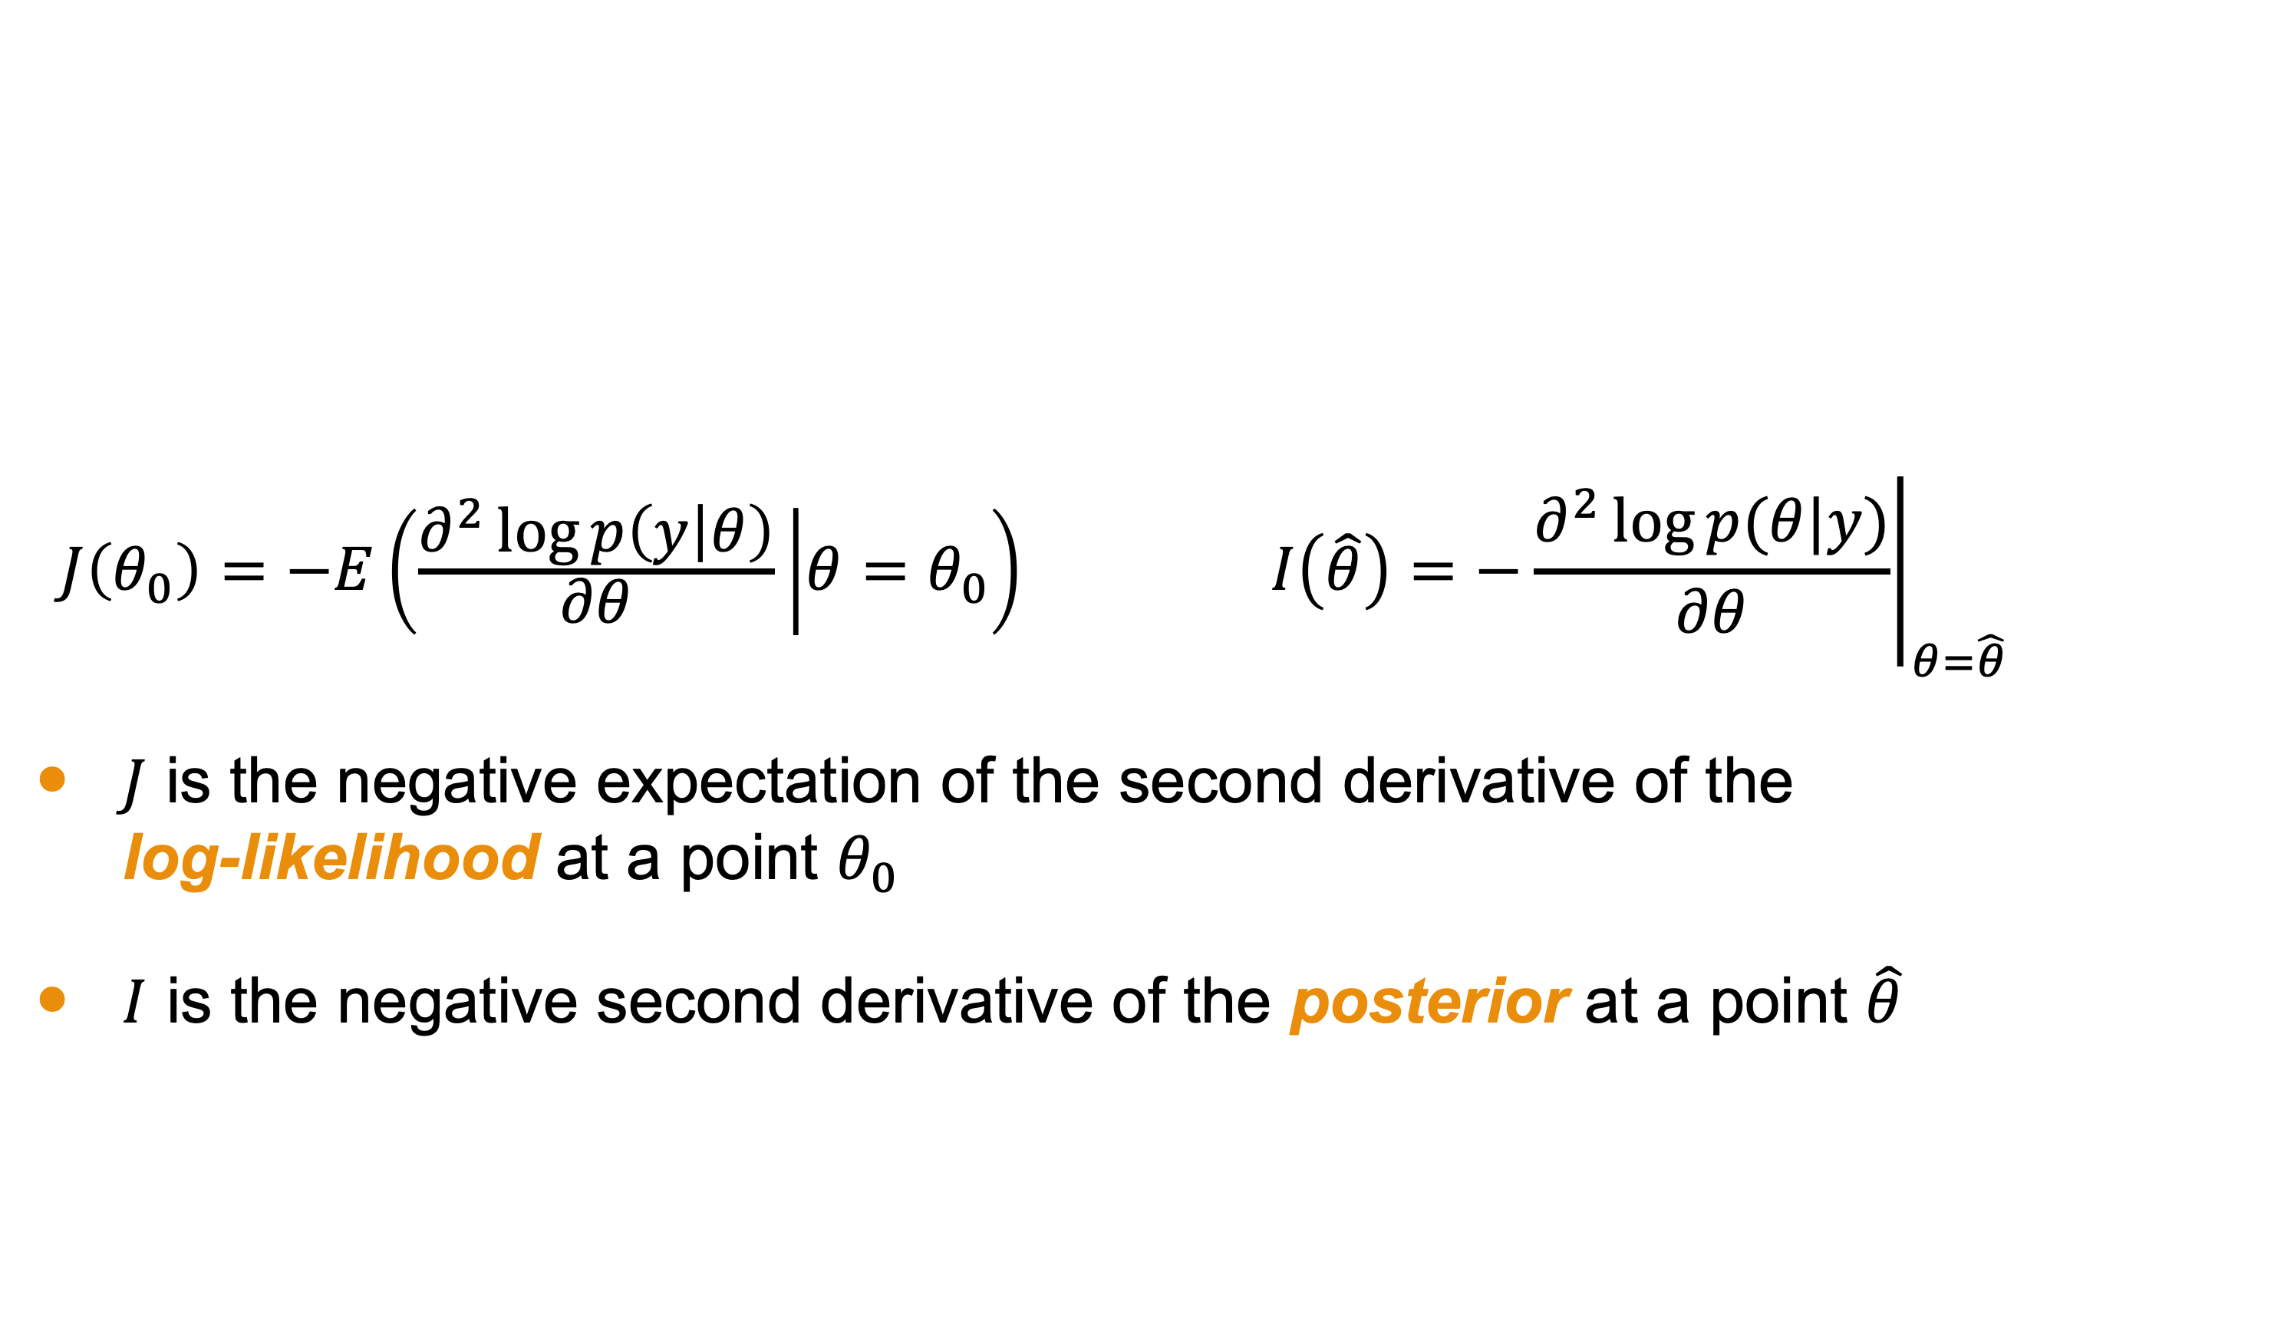

Comparing $J(θ)$ and $I(θ)$
$$J\left(θ_{0}\right)=−E\left(\frac{∂^{2}\log{p\left(y | θ\right)}}{∂θ} | θ=θ_{0}\right) I\left(\hat{θ}\right)={\left.−\frac{∂^{2}\log{p(θ|y)}}{∂θ}\right|}_{θ=\hat{θ}}$$
$J$ is the negative expectation of the second derivative of the log-likelihood at a point $θ_{0}$
$I$ is the negative second derivative of the posterior at a point $\hat{θ}$

Slide 18
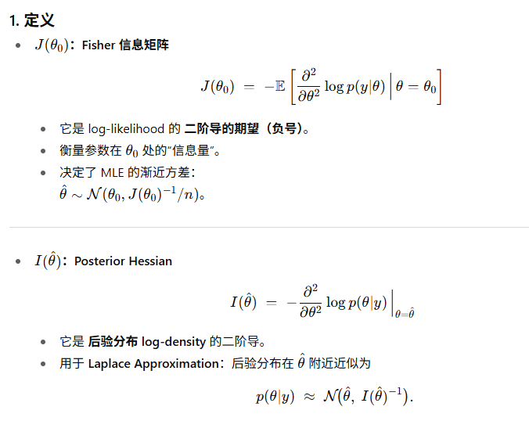
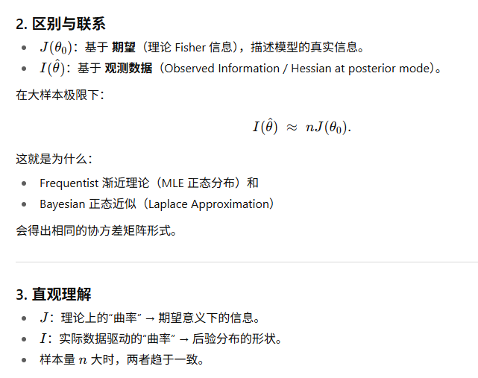

Comparing $J(θ)$ and $I(θ)$
Notes:
Sketch of proof of theorem 3

Slide 19
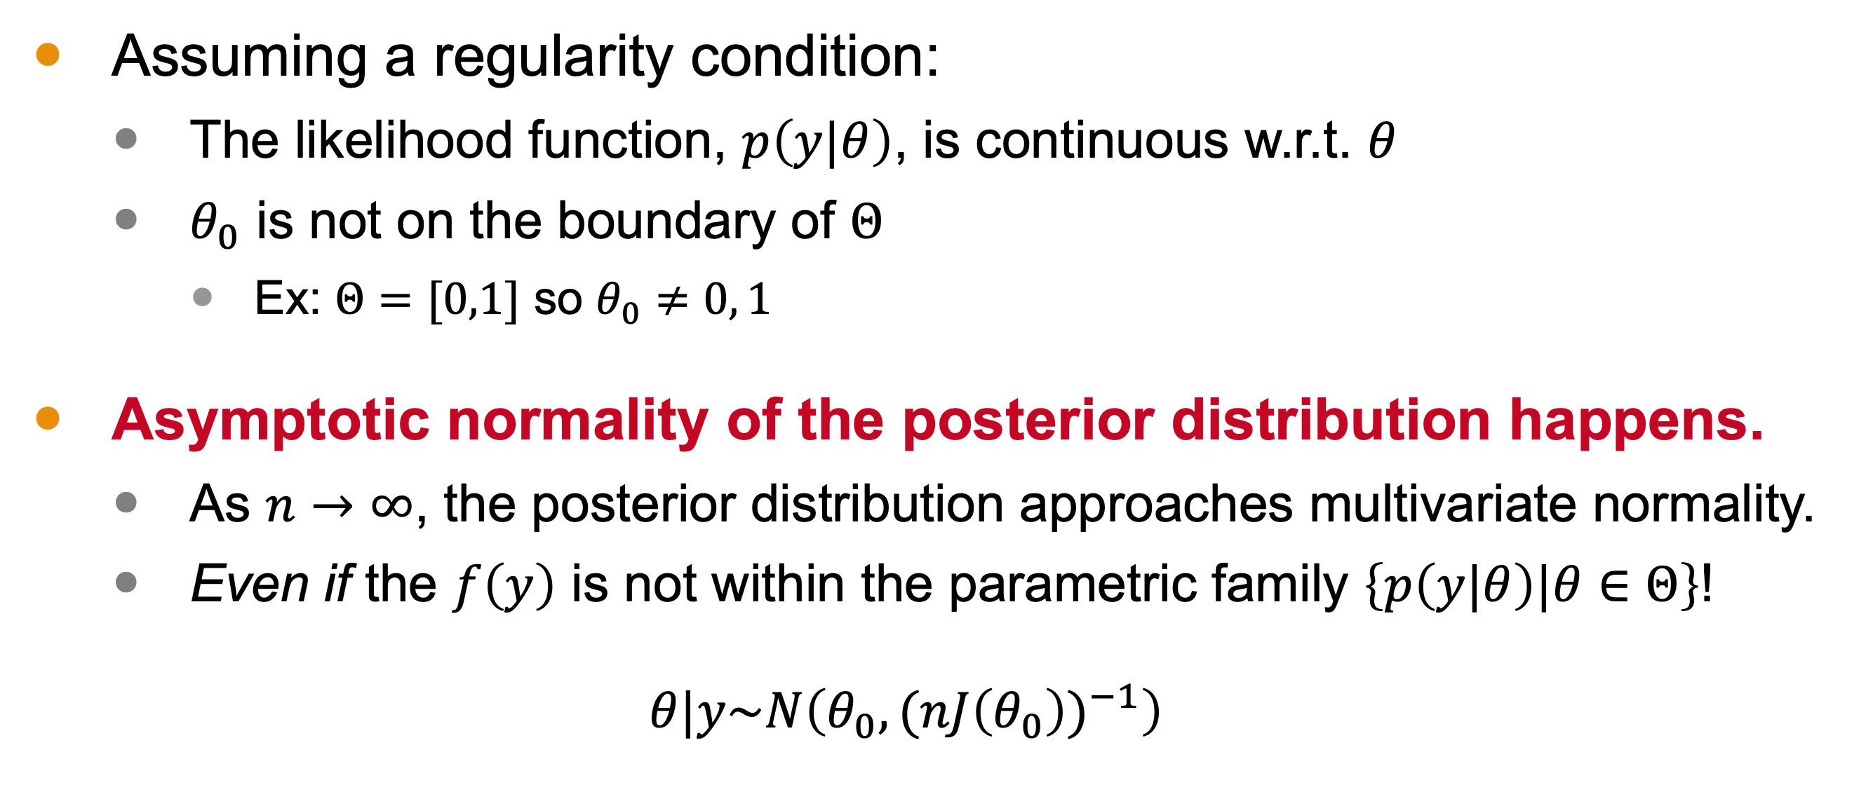
Asymptotic Normality Summary
Assuming a regularity condition:
The likelihood function, $p\left(y|θ\right)$, is continuous w.r.t. $θ$
$θ_{0}$ is not on the boundary of $Θ$
Ex: $Θ=[0,1]$ so $θ_{0}≠0, 1$
Asymptotic normality of the posterior distribution happens.
As $n→∞$, the posterior distribution approaches multivariate normality.
Even if the $f\left(y\right)$ is not within the parametric family $\left\{p\left(y|θ\right)|θ∈Θ\right\}$!
$$θ|y\sim N\left(θ_{0},{(nJ\left(θ_{0}\right))}^{−1}\right)$$
Notes:
If Scenario 1 happens, then the posterior distribution converges to a point mass at the true parameter value, θ0, as n → ∞, and θ0 is the true parameter value. Consistency holds!
If Scenario 2 happens, then the posterior distribution converges to a point mass at the parameter value θ0, where θ0 is the minimizer of the KL divergence.

Slide 20
Consequences
Large samples mean we can approximate our posterior with normal distributions and have decent results.
This illustrates that, as the sample size increases, the prior’s influence on the posterior distribution diminishes.
We need not stress over our choice of prior is the sample is very large.

Slide 21
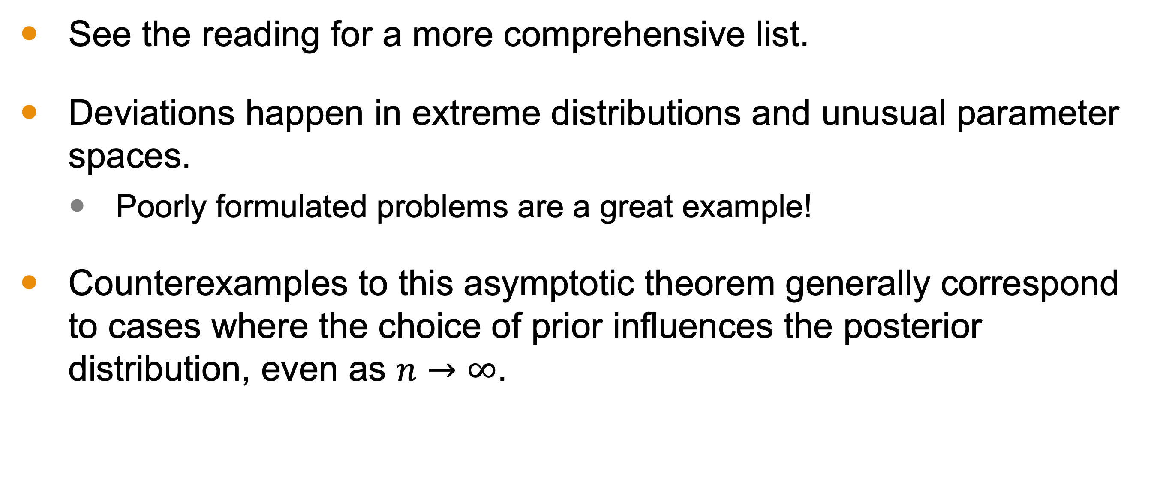
Counterexamples to Theorems
See the reading for a more comprehensive list.
Deviations happen in extreme distributions and unusual parameter spaces.
Poorly formulated problems are a great example!
Counterexamples to this asymptotic theorem generally correspond to cases where the choice of prior influences the posterior distribution, even as $n→∞$.

Slide 22
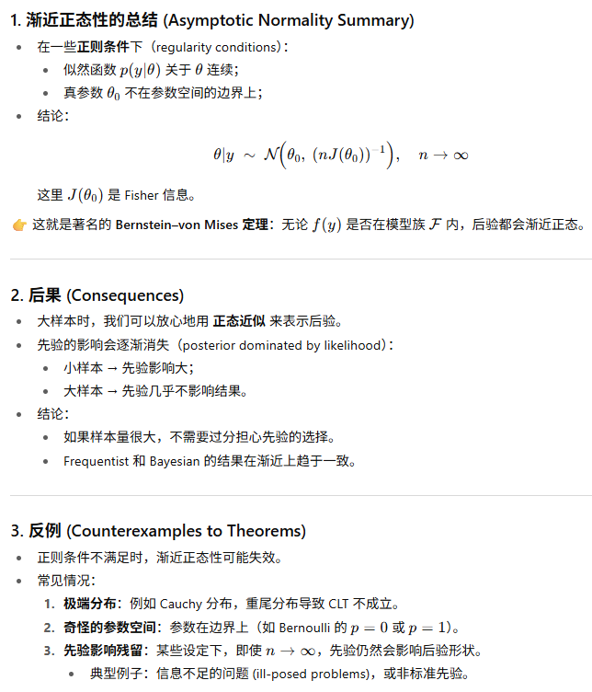
Summary

